Slide 1
Waste Classification API
Deep Learning • FastAPI • Docker • Kubernetes
- A Real-Time Deep Learning Deployment for Environmental Impact
By Ramya Subramanian Porselva Bharathi

Slide 2
Problem Statement & Objective
This project aims to automate waste classification using deep learning, making recycling smarter and scalable.
Environmental Urgency
Global waste production is rising rapidly, expected to reach 3.4 billion tons by 2050. Mismanaged waste contributes to pollution, health hazards, and climate change.
Circular Economy Challenge
Circular economies (e.g., TOMRA's mission) rely on efficient waste sorting and recycling. Manual sorting is slow, error-prone, and labor-intensive.
The Need for Smart Waste Sorting
AI-powered solutions can automate the classification of waste at recycling centers. Improves recycling efficiency, reduces contamination, and promotes sustainability.
Role of Machine Learning
Machine Learning models can classify waste images like plastic, glass, metal, etc. Enables real-time predictions for automated waste segregation systems.

Slide 3
Technical Overview
Python - A Core programming language used for model development and API integration.
TensorFlow & Keras- Used to build and train the convolutional neural network (CNN) for image classification.
FastAPI - A Lightweight, high-performance web framework used to serve the ML model via REST API.
Docker - Containerized the ML application to ensure portability and environment consistency.
Kubernetes (Minikube) - Used for local container orchestration and scaling, simulating real-world deployment scenarios.
NumPy - Used for handling image arrays and numerical operations.
Pillow - Used to preprocess uploaded image files before feeding them into the ML model.
Uvicorn - A lightning-fast ASGI server used to deploy the FastAPI app locally and within the Docker container.
Git & GitHub for version control

Slide 4
Project Overview
- Trained CNN model to classify waste images (plastic, paper, glass, etc.)
- Served model via FastAPI for real-time predictions
- Containerized with Docker
- Deployed using Kubernetes (Minikube)
- Exposed REST API via Swagger UI

Slide 5
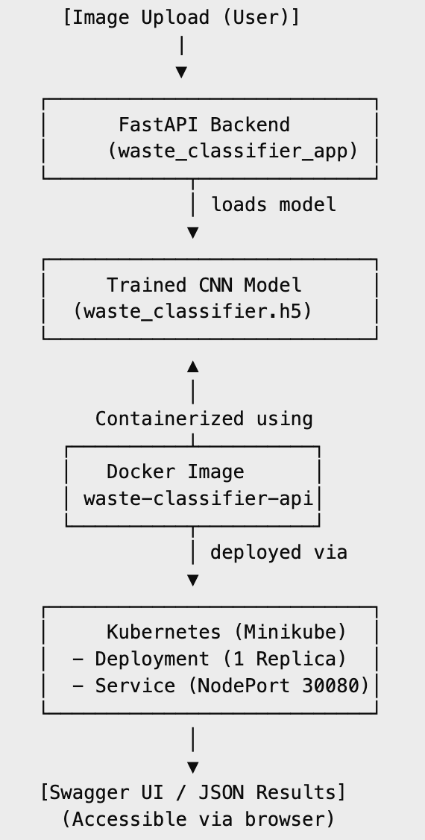
Architecture Diagram

Slide 6
Dataset Summary
Dataset: Garbage Classification Dataset (Kaggle)
Categories (6 classes): Cardboard, Plastic, Metal, Glass, Paper, Trash
Directory Structure:
Images were categorized into folders by class to facilitate model training
Image Size:
All images resized to 150 × 150 pixels
Preprocessing Techniques:
Rescaling pixel values (0–255 → 0–1)
Normalization using ImageDataGenerator
Data Split:
80% Training set
20% Validation set
Tool Used for Preprocessing:
ImageDataGenerator from Keras

Slide 7
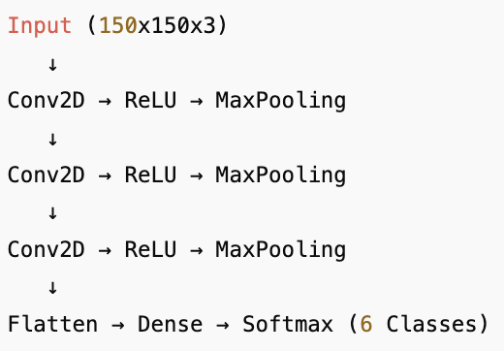
CNN Architecture - A Convolutional Neural Network (CNN) was designed to classify waste into 6 categories. Architecture includes: 3 Convolutional Layers (Conv2D): Extract spatial features using filters. MaxPooling Layers after each Conv layer: Reduce dimensionality and preserve key features. Flatten Layer: Converts 3D output to 1D for the dense layer. Dense Layer: Learns high-level feature patterns. Softmax Output Layer: Provides class probabilities for 6 waste categories. Training Configuration Optimizer: Adam Loss Function: Categorical Cross-Entropy Activation Functions: ReLU (hidden layers), Softmax (output layer) Output: The final model outputs a 6-class probability distribution (cardboard, glass, metal, paper, plastic, trash).
Model Architecture

Slide 8
Model Training Summary Number of Epochs: Trained for 30 epochs with early stopping Batch Size: 32 Accuracy & Loss Curves Training and validation accuracy steadily improved across epochs. Loss decreased consistently with minimal overfitting. Class Mapping Output print("Class indices:", train_data.class_indices) Output: {'cardboard': 0, 'glass': 1, 'metal': 2, 'paper': 3, 'plastic': 4, 'trash': 5} Output: waste_classifier.h5 (saved model) Class labels saved in class_names.txt
Training & Evaluation

Slide 9
FastAPI Integration
- Built a RESTful API using FastAPI that accepts image uploads via multipart/form-data
- Endpoint: /predict accepts image files
- Swagger UI auto-generated at /docs
- Returns predicted class and confidence score

Slide 10
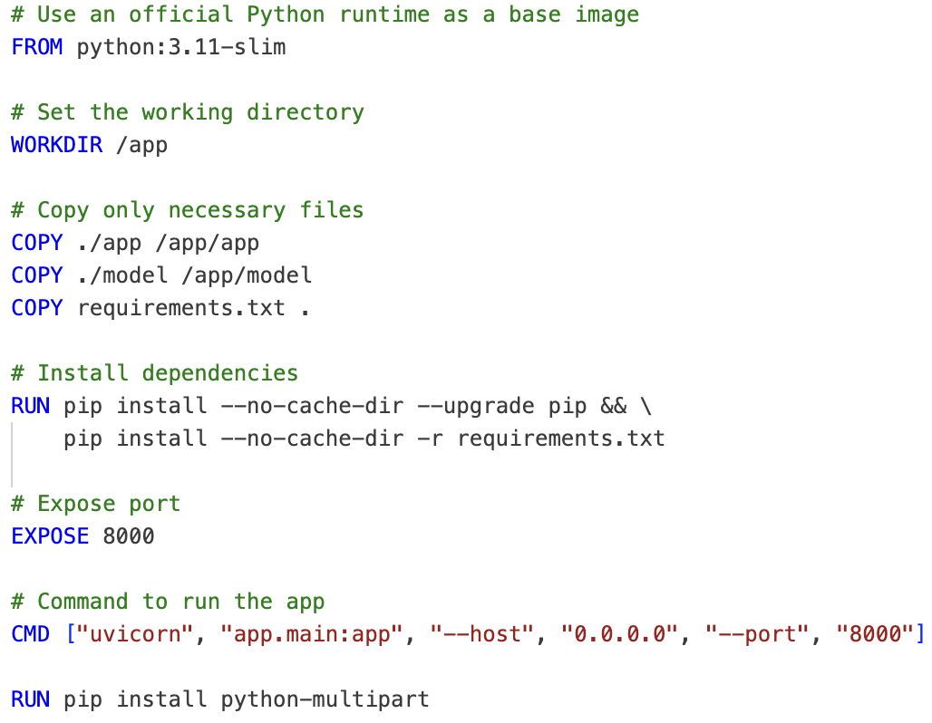
Docker Containerization
Dockerfile content
Defines app environment using Dockerfile.
Copies app and model directories into the container.
Installs dependencies from requirements.txt.
Runs Uvicorn server on port 8000.
Installs TensorFlow, FastAPI, and other dependencies.
Docker image is built using: docker build -t waste-classifier-api .
Output of docker images:

Slide 11
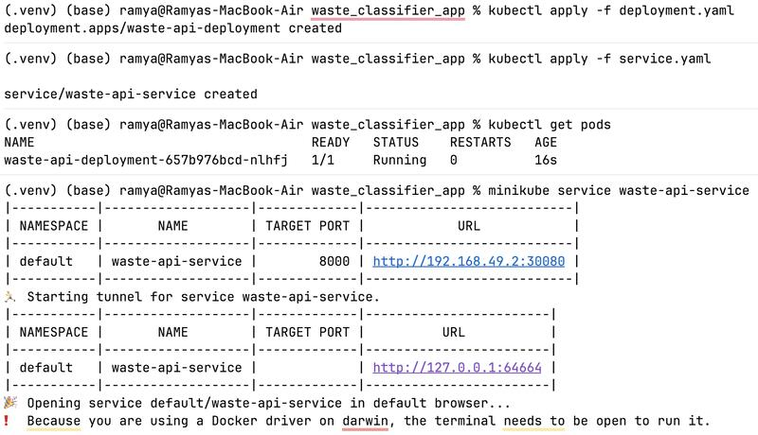
Kubernetes Deployment
deployment.yaml: ▪ 1 replica ▪ Container port: 8000 ▪ imagePullPolicy: Never
service.yaml: ▪ Exposes NodePort on 30080
Minikube: ▪ Used to host the app locally

Slide 12
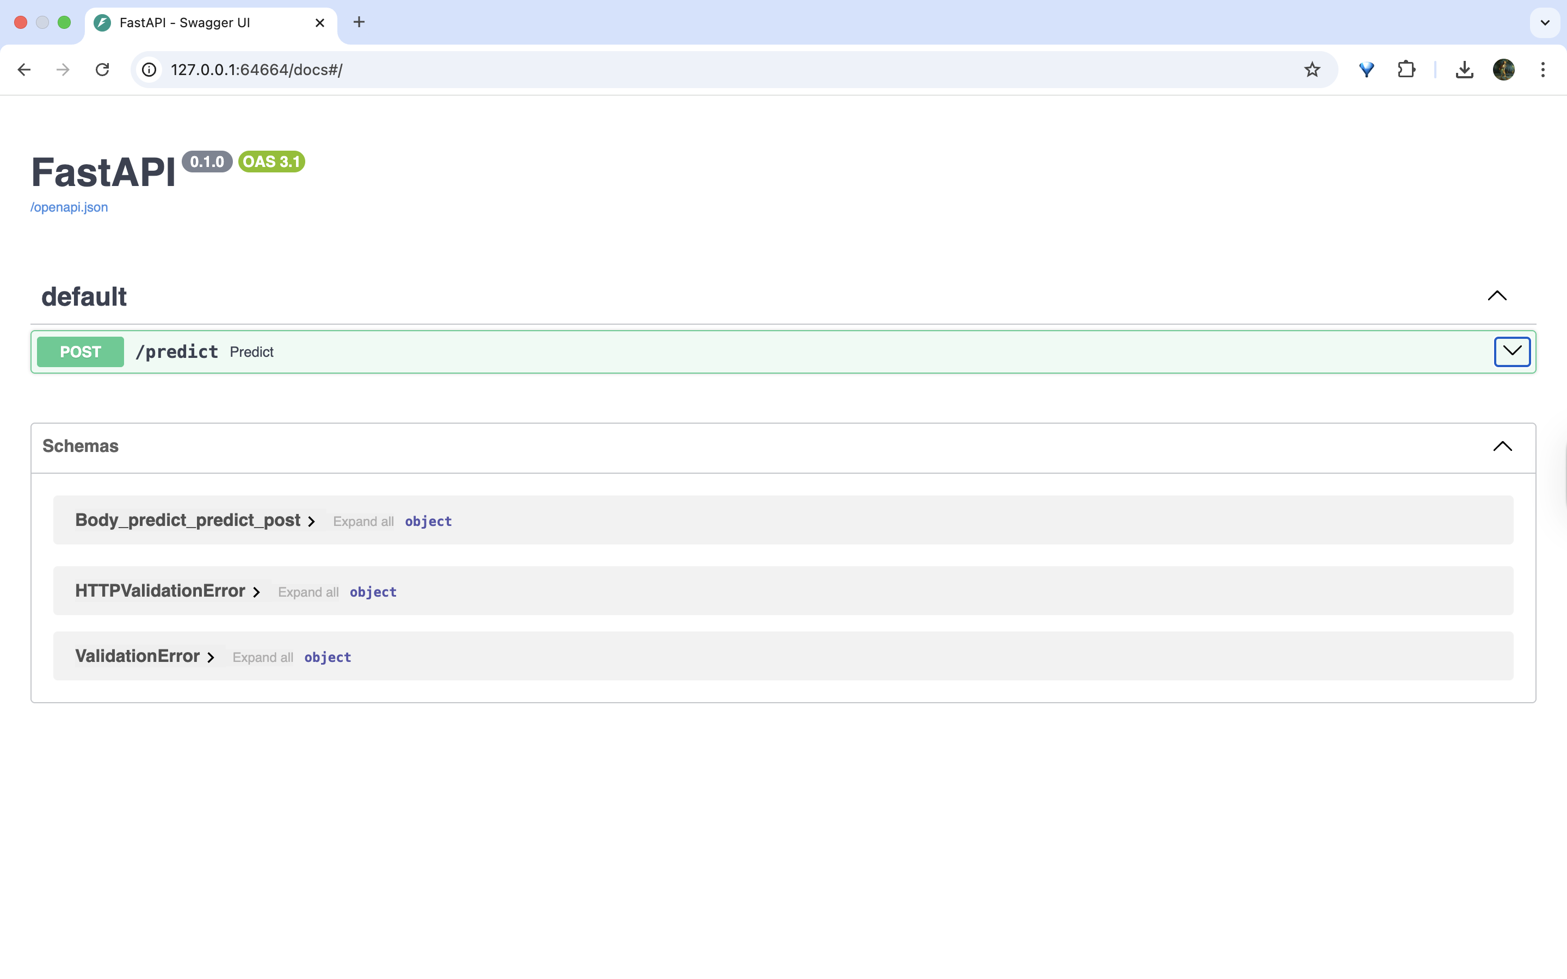
Live API Demo

Slide 13
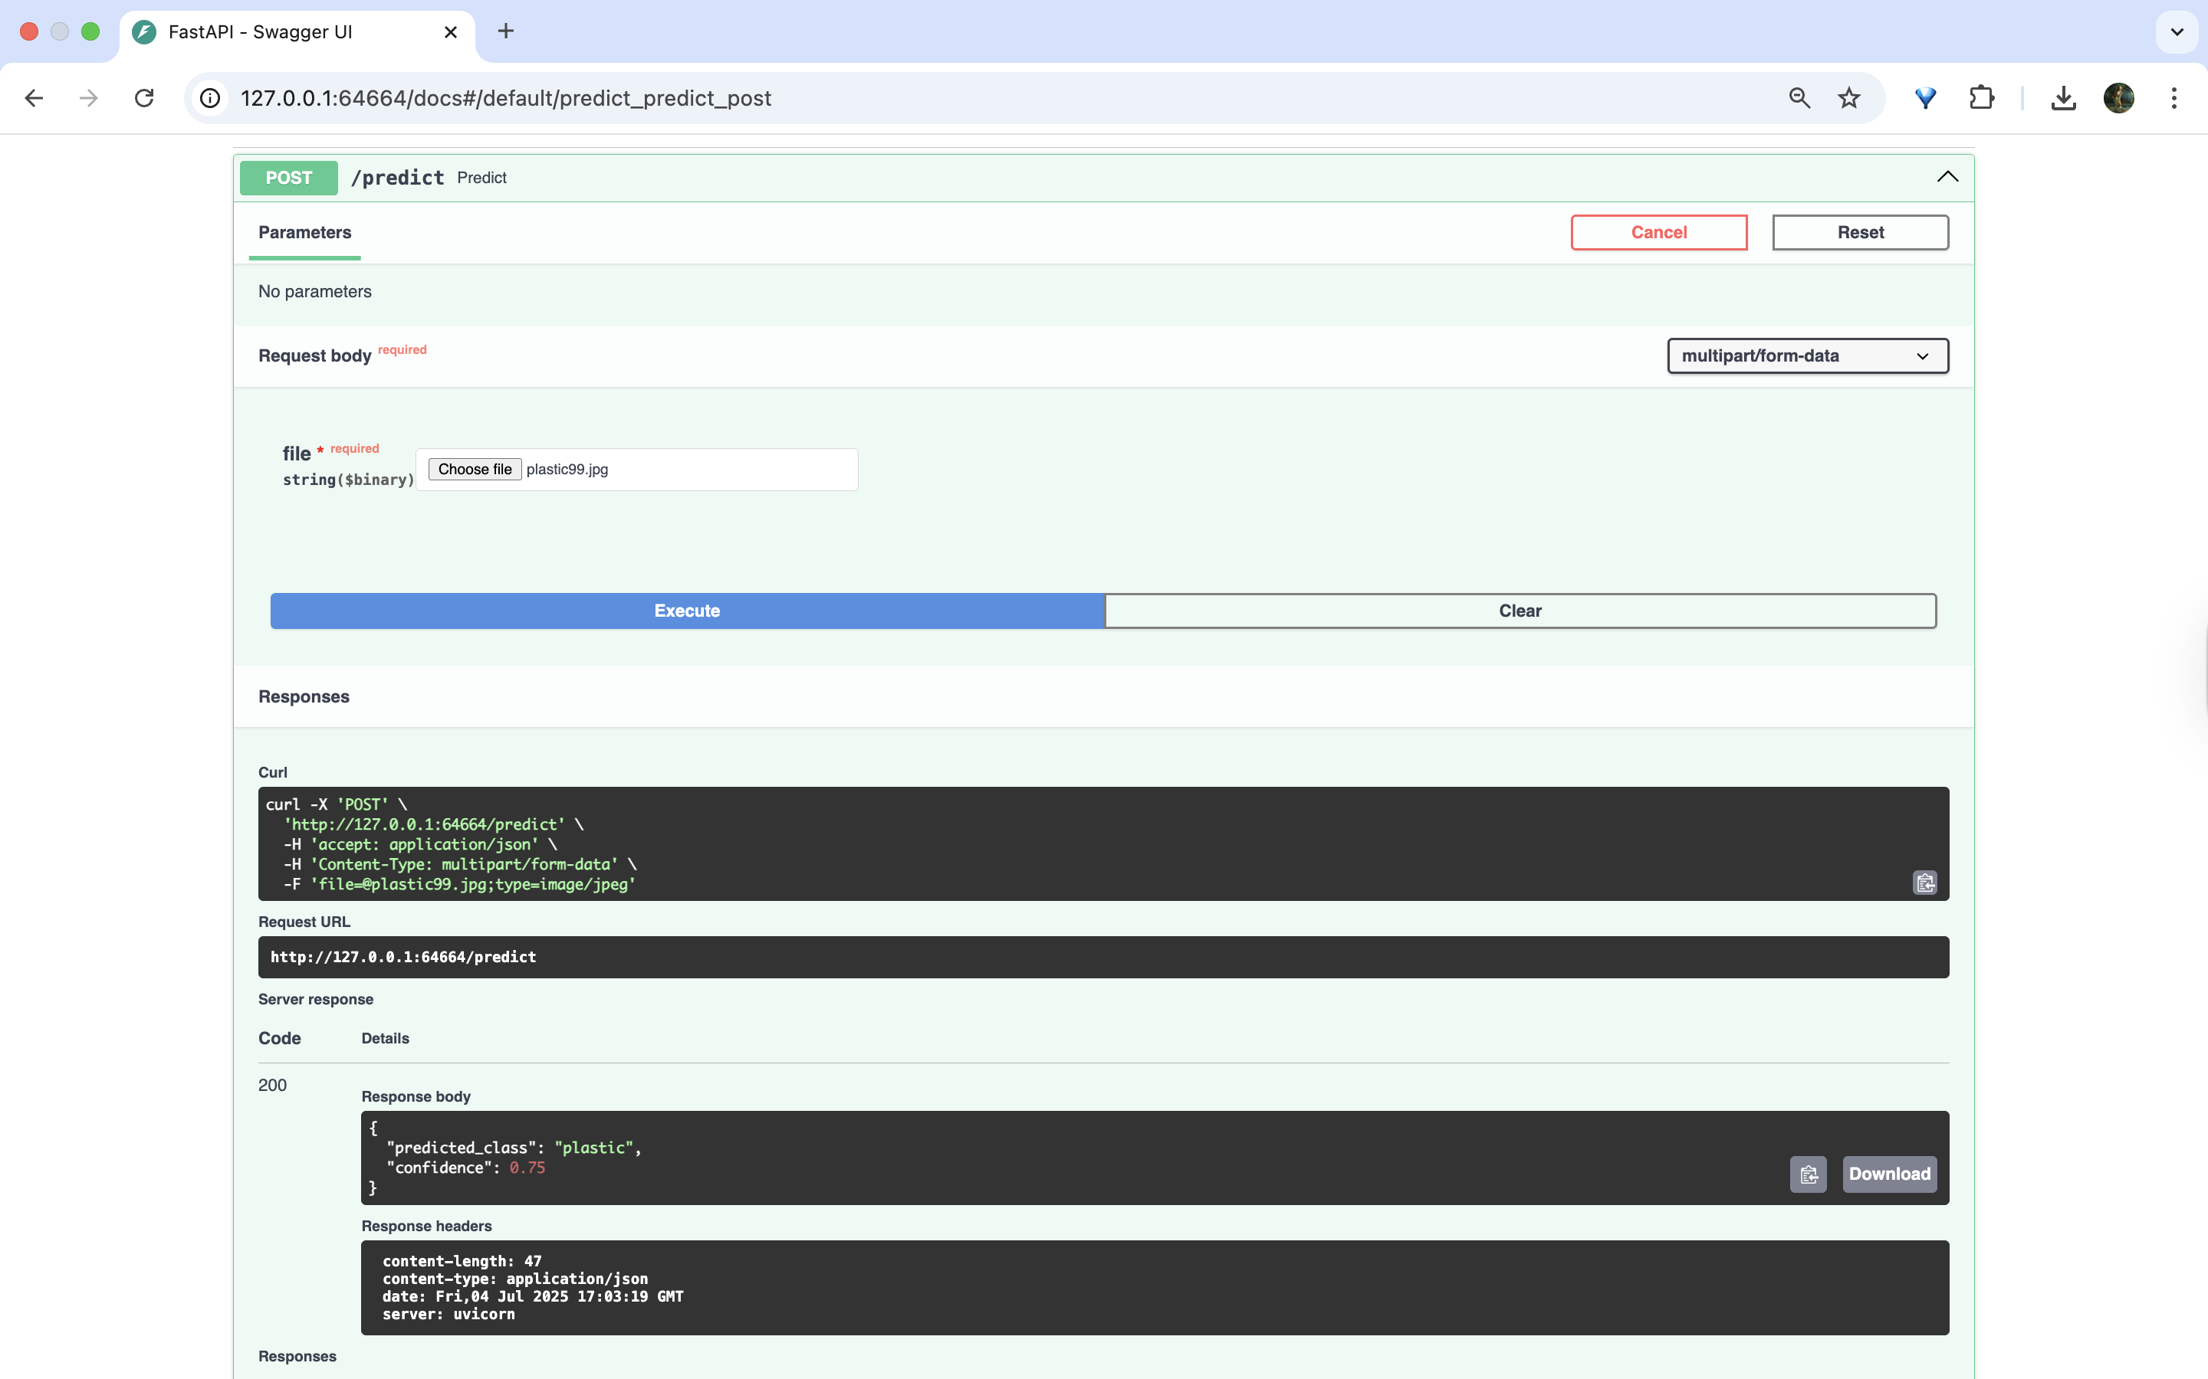
Live API Demo

Slide 14
Learnings & Challenges
Learnings
Gained hands-on experience building RESTful APIs with FastAPI
Learned how to build Docker images and run containers locally
Understood Kubernetes fundamentals: Deployments, Pods, Services
Showcased end-to-end ML model deployment with Docker and Kubernetes
Developed skills in debugging container issues: ▪ ImagePullBackOff: Fixed using Minikube’s Docker and imagePullPolicy: Never ▪ Docker container crash: Resolved by adding python-multipart to requirements.txt ▪ Prediction consistency: Fixed class mismatch by aligning training class indices with prediction mapping
Gained real-world relevance to TOMRA and sustainability by building an eco-friendly waste classification system
Hands-on experience with model training, APIs, CI, and microservices through the entire workflow
Challenges
Class label mismatch: Ensured class labels in predictions matched those from class_names.txt
Container networking issues in Minikube: Resolved service reachability by correcting port mappings and ensuring pods were running

Slide 15
Final Summary & GitHub Link
- Built and deployed full-stack waste classification API
- Stack: Python, TensorFlow, FastAPI, Docker, Kubernetes
- Accessible via REST API and documented with Swagger UI
GitHub: https://github.com/RamyaSP6/waste-classifier-api

Slide 16

THANK YOU!

